Slide 1
National Report
Portugal

Slide 2
Introduction
Questionnaire available from 16 to 31 of January, 2023
A total of 210 answers were collected
6 sections
Authorization
Characterization
Assessment and pedagogical documentation
Relation between the pedagogical documentation and learning
Difficulties assessing children
Documentation process and participants

Slide 3
Characterization – work experience
Most of the respondents have 41 to 50 year’s old (26%) and 51 to 60 year’s old (36%)
68% hold the bachelor degree and 27% the master
25% have between 11 and 20 years of work experience and another 25% between 21 and 30. 36% have more than 30 years experience
Most of the kindergarten teachers have between 11 and 20 years of professional experience working in the same institution.

Slide 4
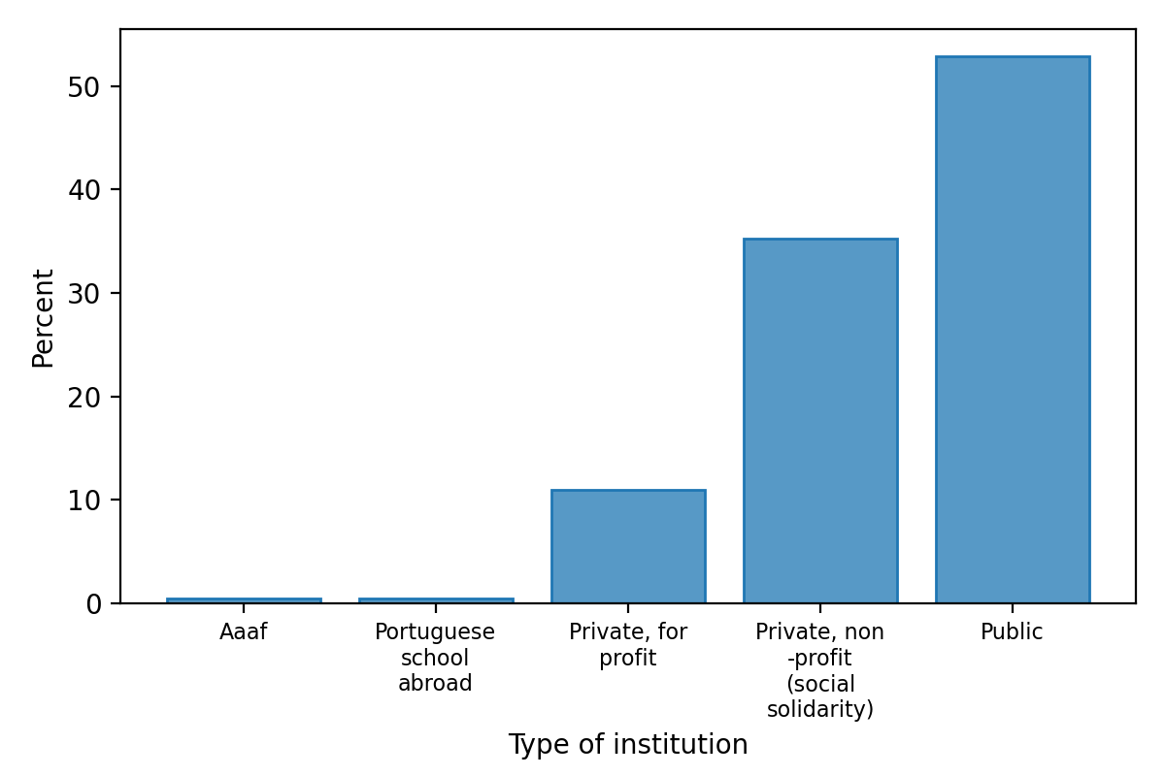
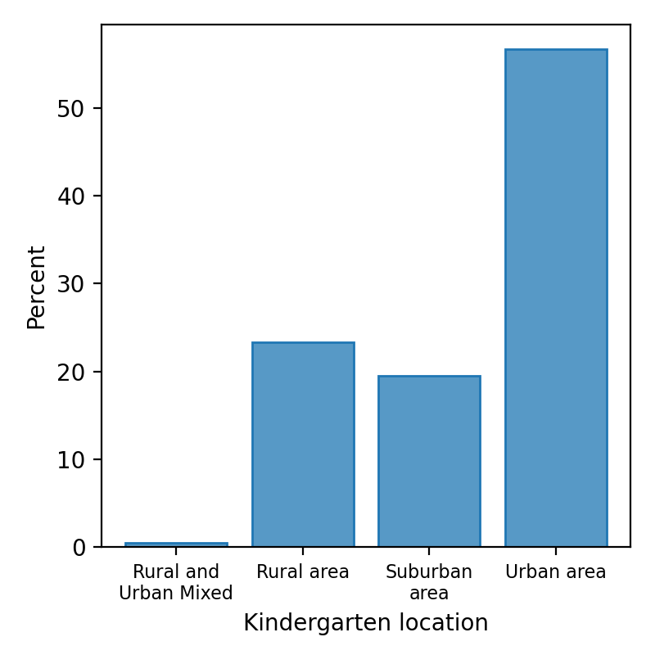
Characterization - institution

Slide 5
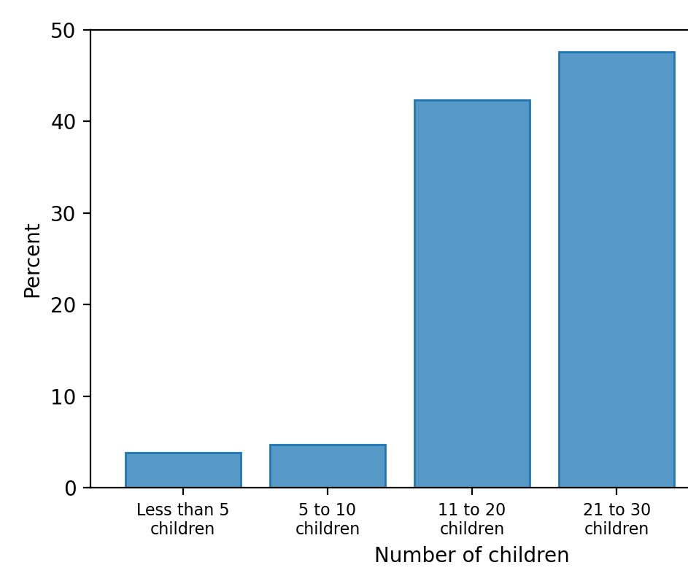
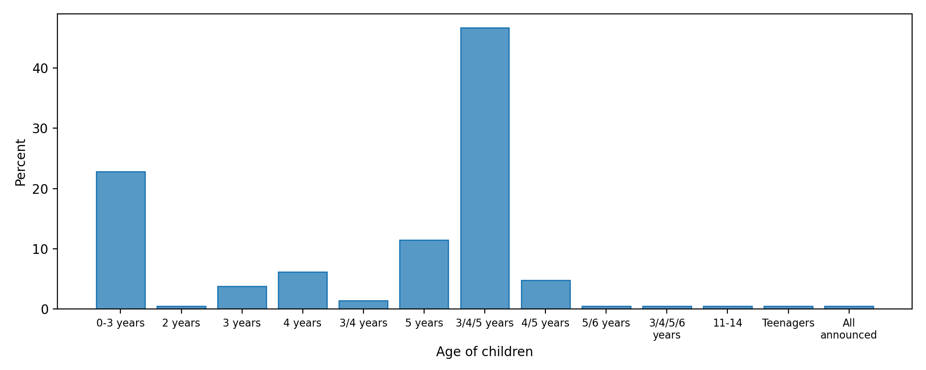
Characterization – children’s groups

Slide 6
Characterization – children’s groups

Slide 7
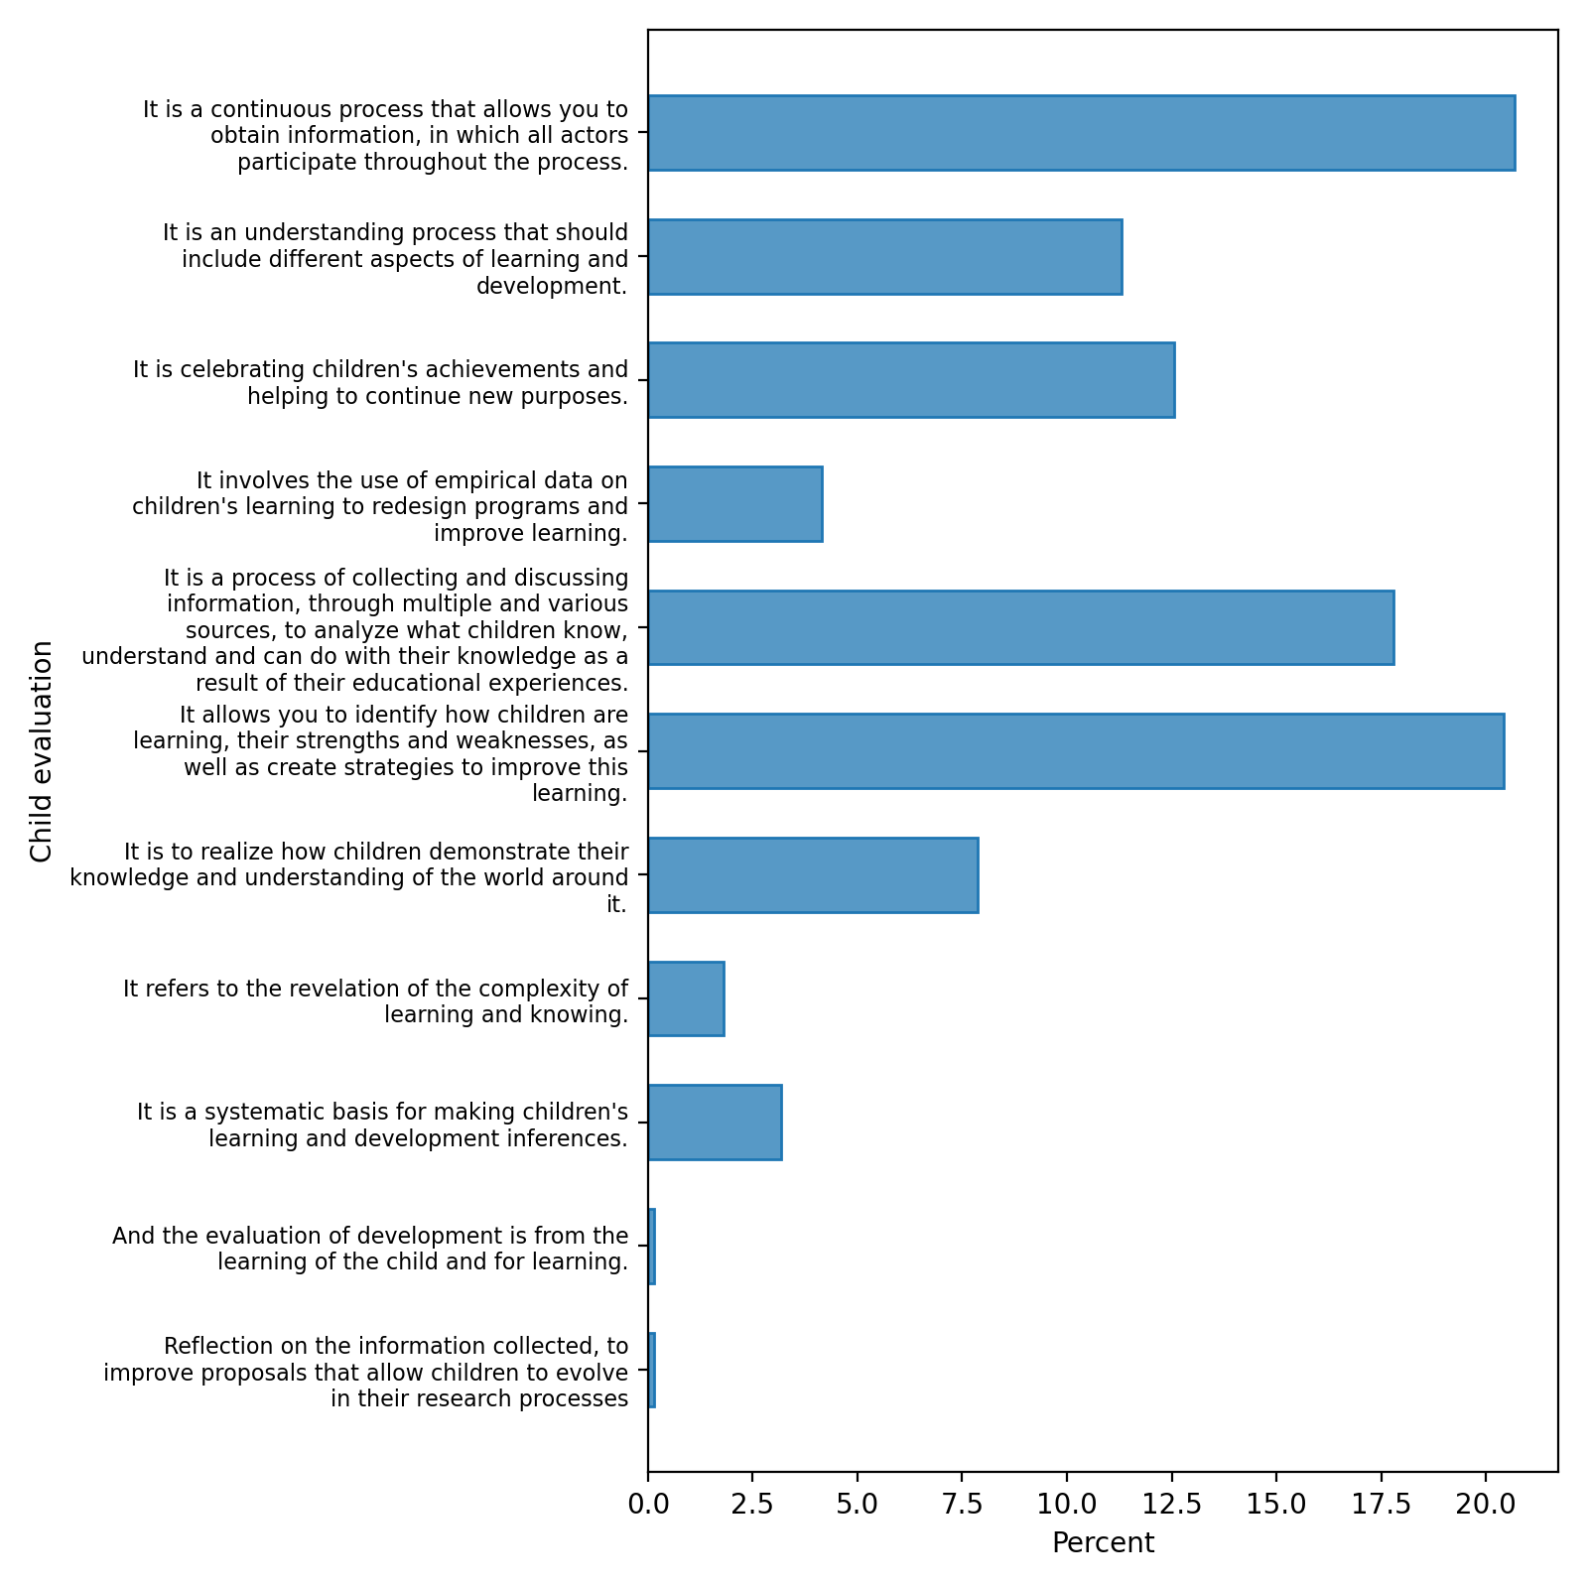
Assessment and pedagogical documentation

Slide 8
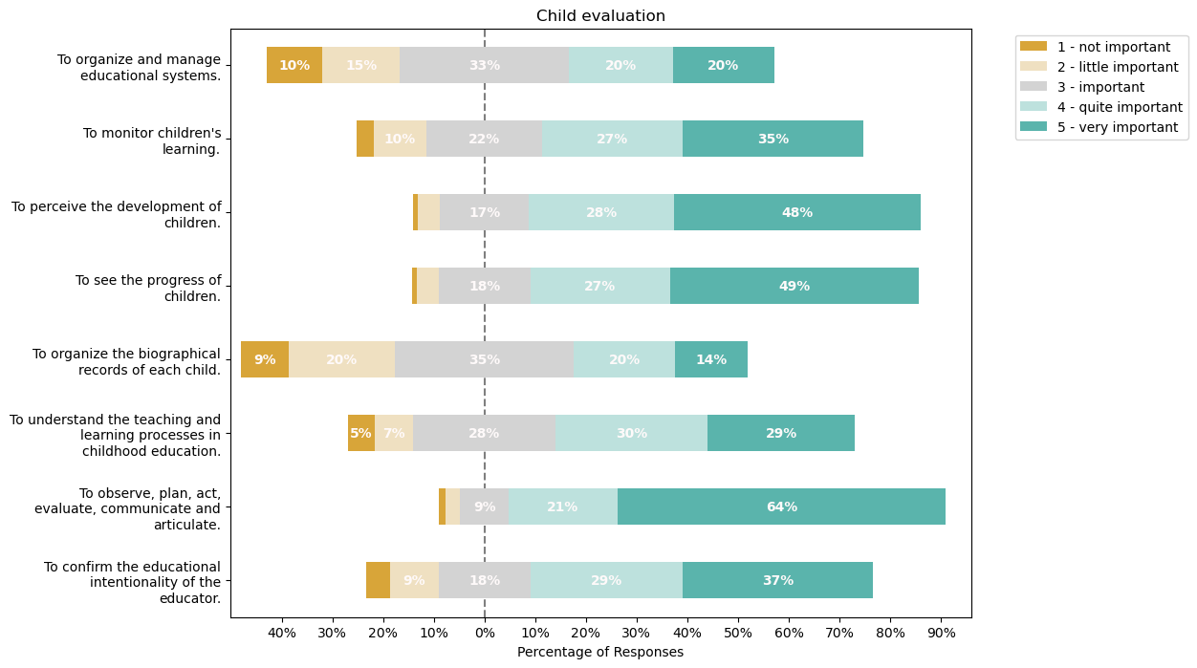
Assessment and pedagogical documentation

Slide 9
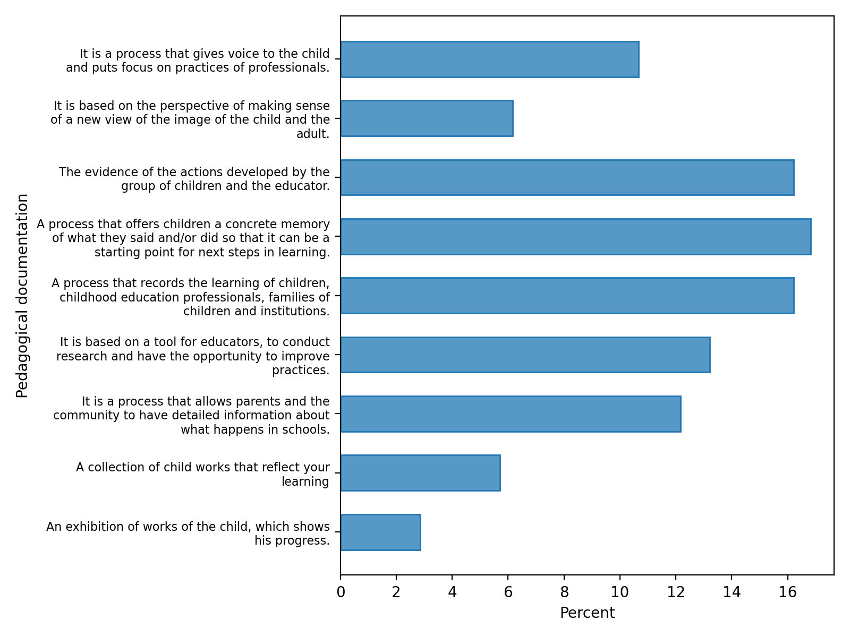
Assessment and pedagogical documentation

Slide 10
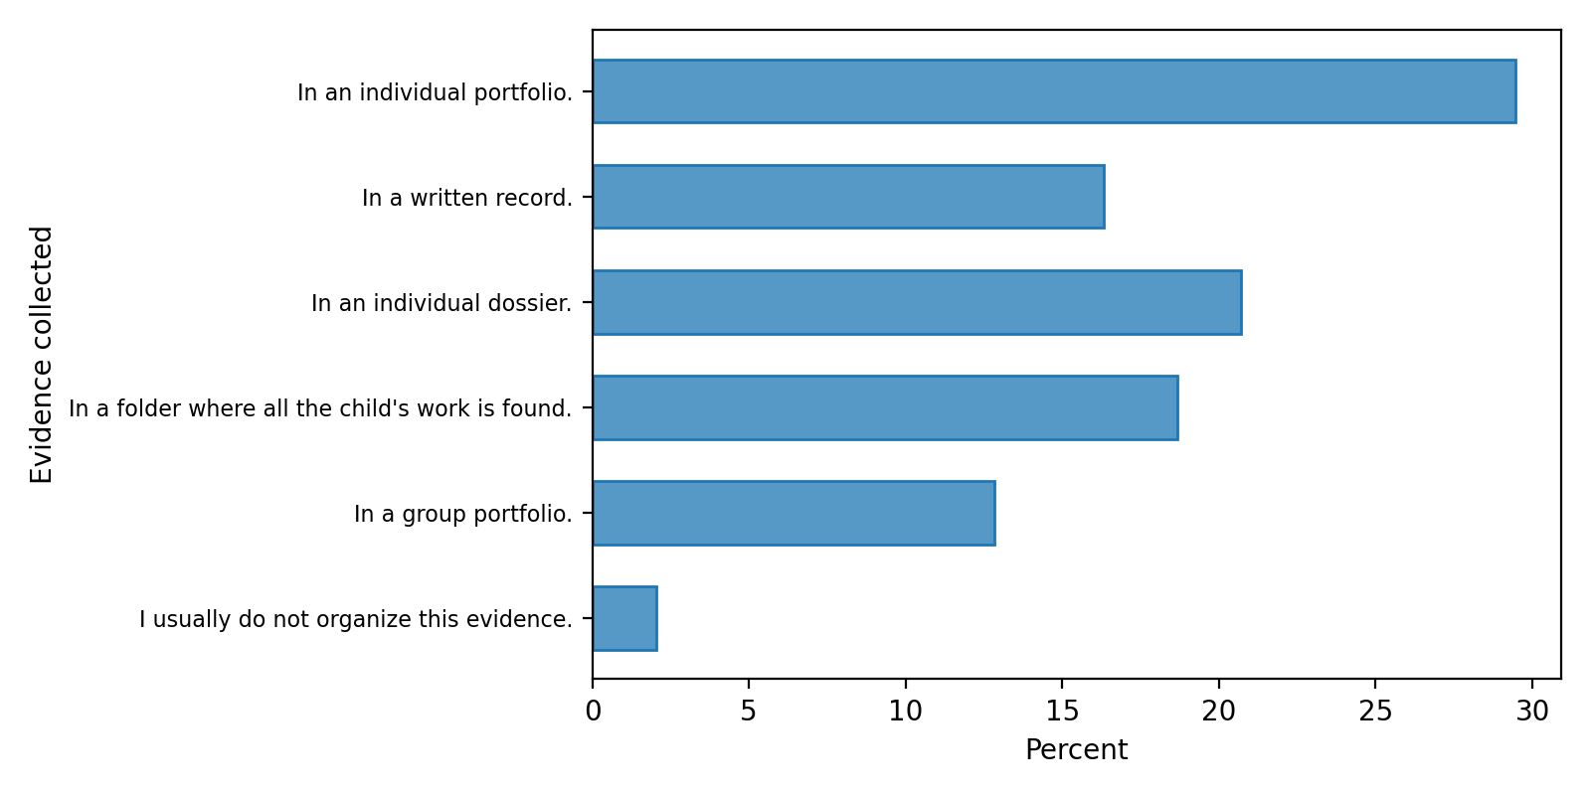
Relation between the pedagogical documentation and learning

Slide 11
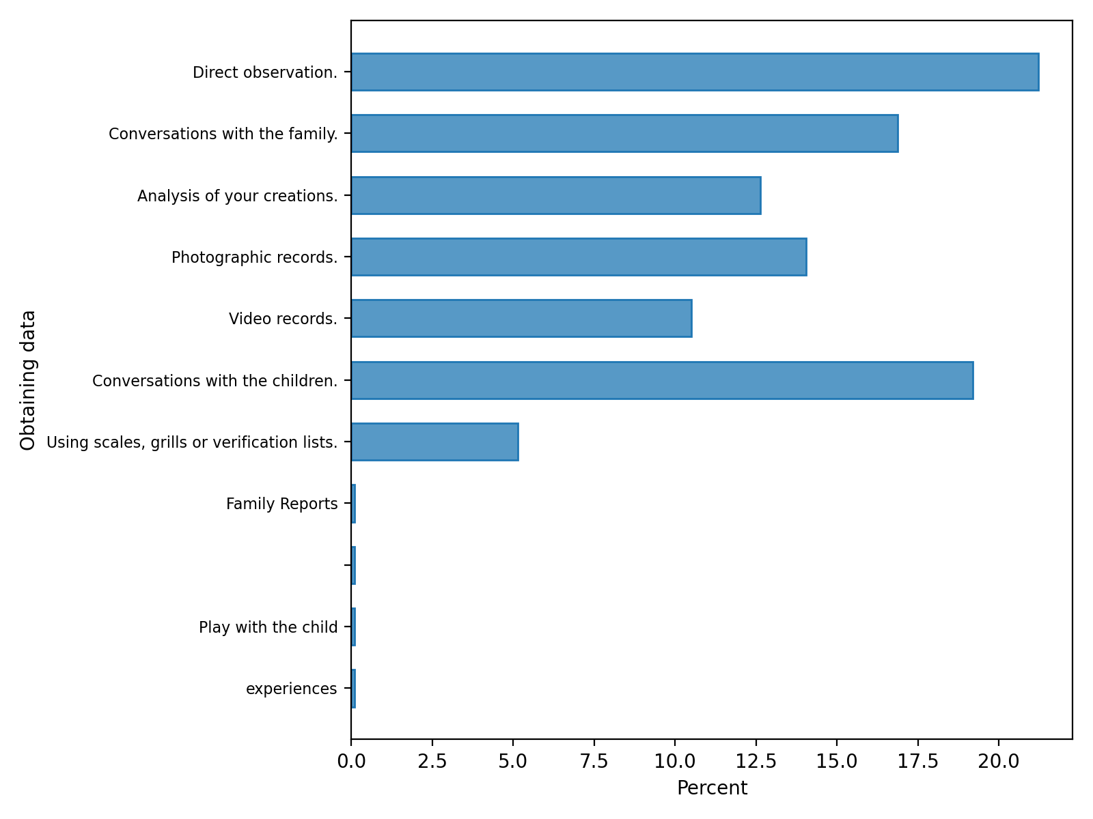
Relation between the pedagogical documentation and learning

Slide 12
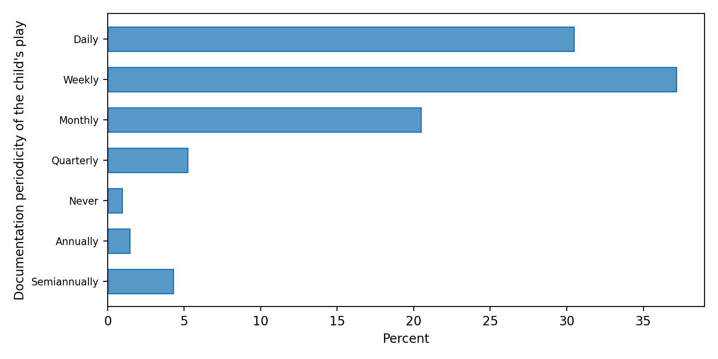
Relation between the pedagogical documentation and learning - play

Slide 13
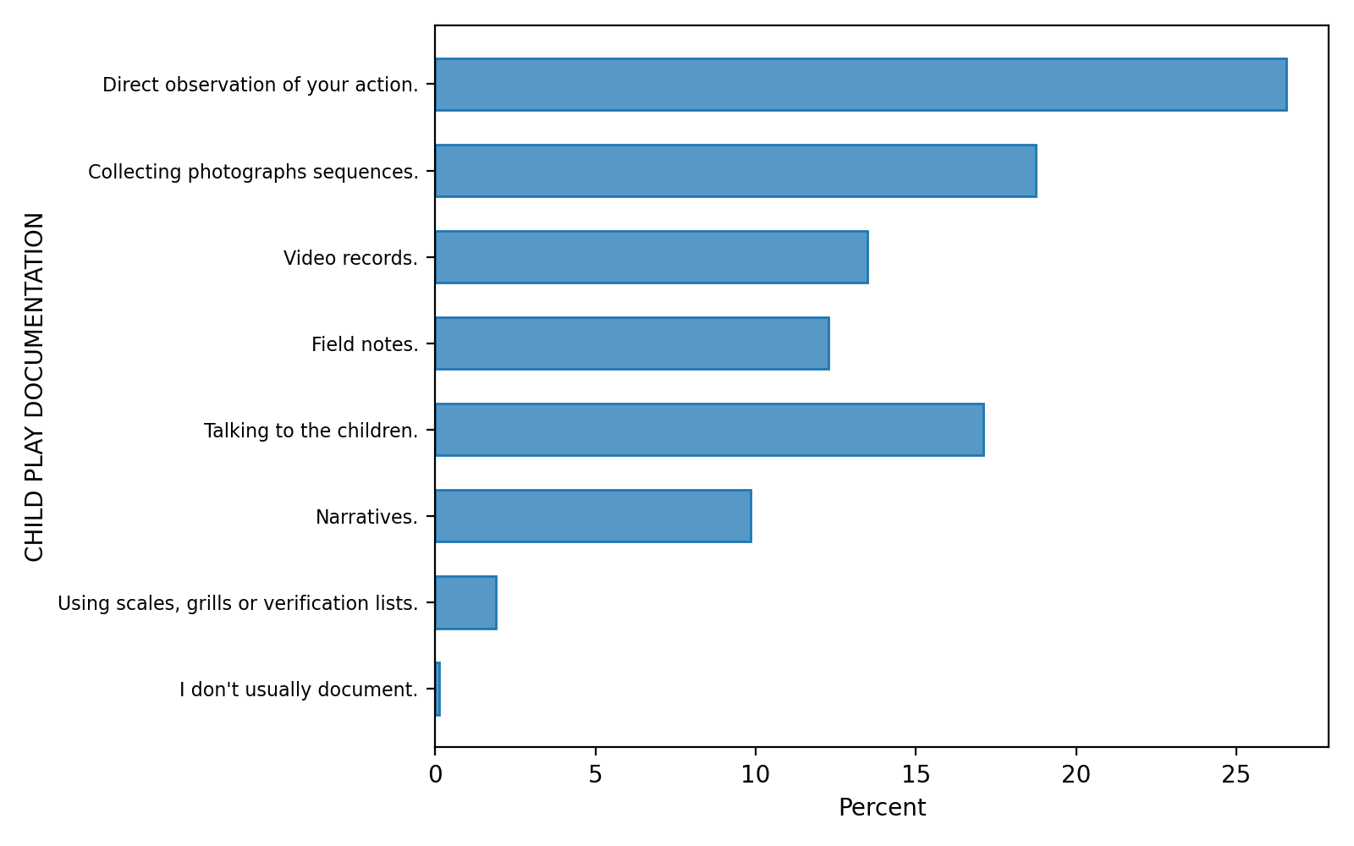
Relation between the pedagogical documentation and learning - play

Slide 14
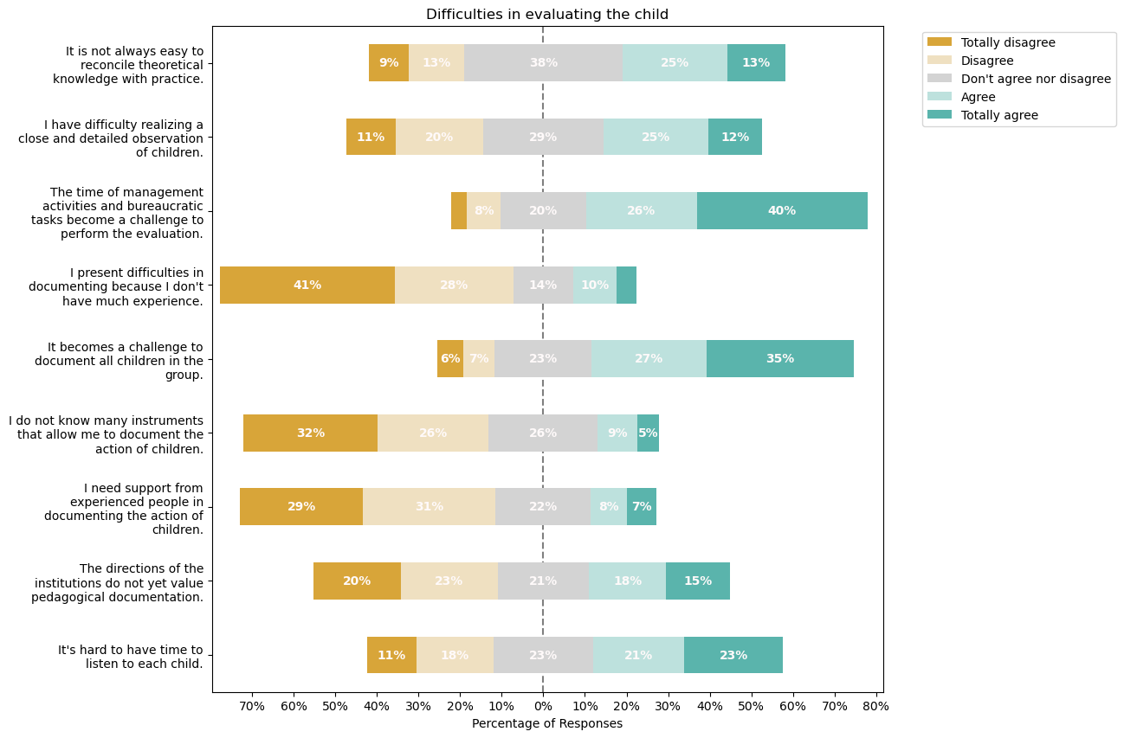
Difficulties assessing children

Slide 15
Documentation process and participants
The participants are varied, although the most significant are:
Kindergarten Teachers – 35%
Child – 25%
Operational assistant – 22%
Family – 22%

Slide 16
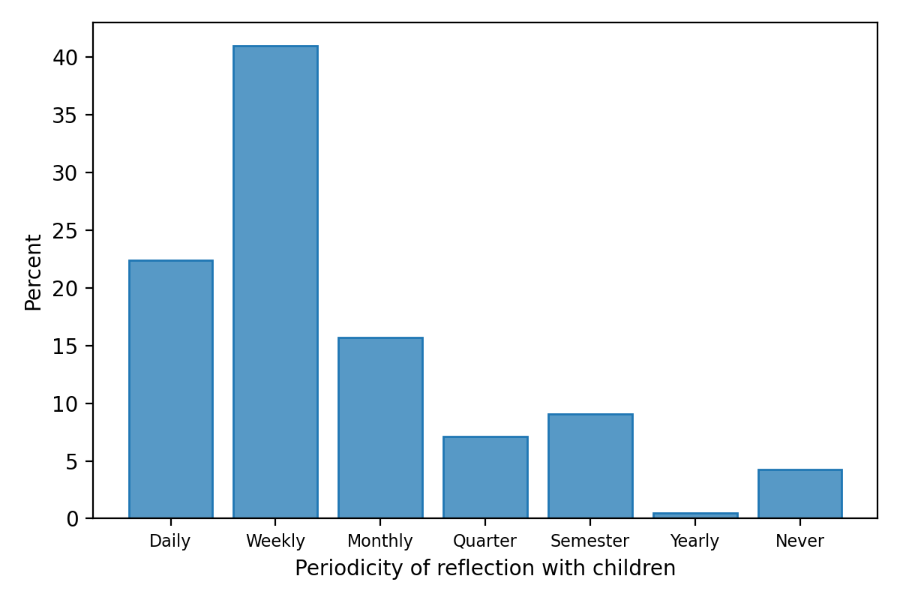
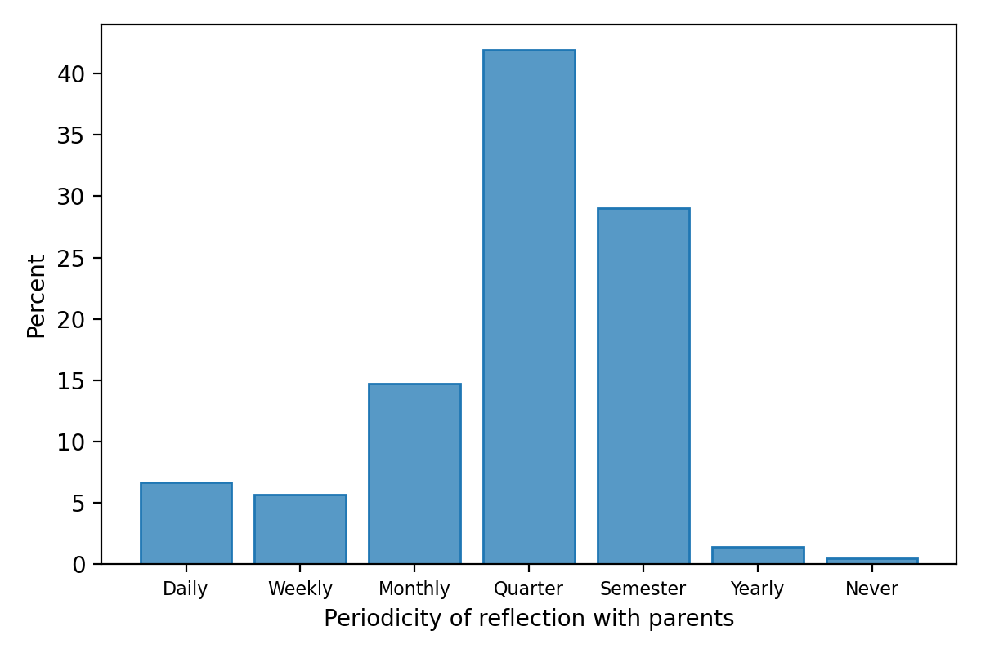
Documentation process and participants

Slide 17
Documentation process and participants
87% think that a digital application would make documentation and assessment process easier
Improving several aspects:
Sharing photos and videos
Registration of summaries
Exchange messages with families
Creating groups of portfolios
Evaluate each child in the group
Creation of individual portfolios
…

Slide 18
Final remarks
We are on it!!

